Slide 1

UNIT 1: Who am I?
The letters

Slide 2
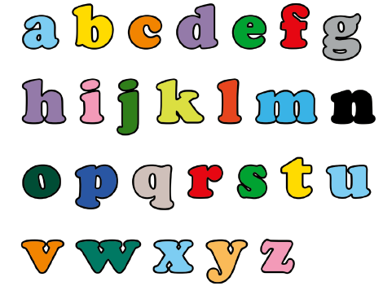

Read the English alphabet.
How many letters are there?
26
https://www.e-sfera.hr/dodatni-digitalni-sadrzaji/2c5d7d36-9df0-42be-acb6-8292742ca509/
Let’s sing!

Slide 3
https://www.bookwidgets.com/play/t:Vrkr337c0OV3ZBWoPpzz4LARPVmlDGONEqixU9ilTio5RUpOVlg=

Slide 4
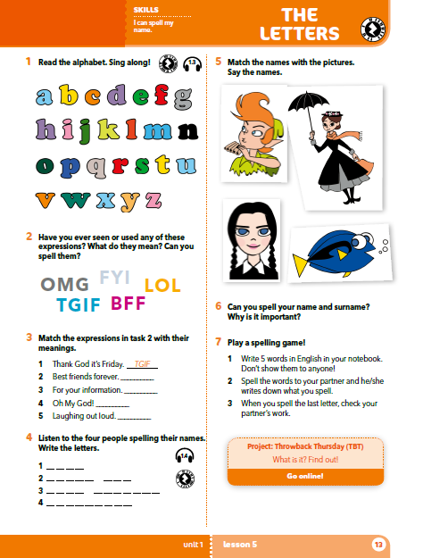
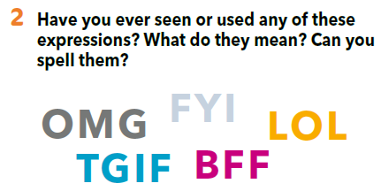
Have you ever seen or used any of these expressions? What do they mean?
Can you spell them?

Slide 5
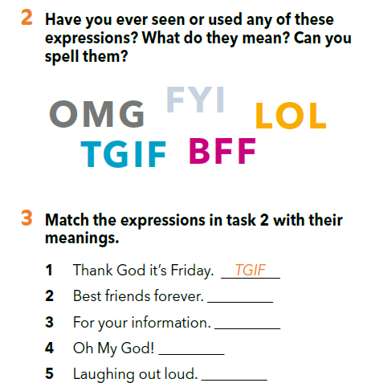
Match the expressions from task 2 with their meanings.
Think up your own abbreviation.
BFF
FYI
OMG
LOL

Slide 6
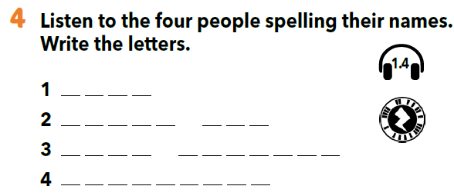
1
D O R Y
2
P E T E R P A N
3
M A R Y P O P P I N S
W E D N E S D A Y
4
Listen to the four people spelling their names. Write the letters.

Slide 7
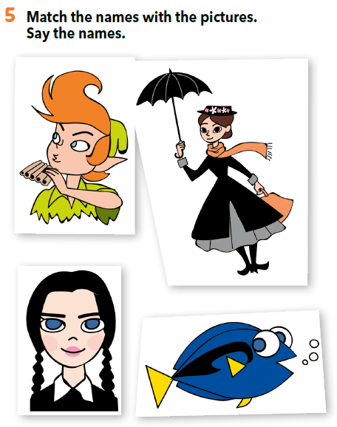
Match the names from task 4 with the pictures. Say the names.
MARY POPPINS
PETER PAN
DORY
WEDNESDAY

Slide 8
What do you know about these characters? Can you describe them?
MARY POPPINS
PETER PAN
Can you spell your name and surname? Why is it important?
WEDNESDAY
DORY

Slide 9
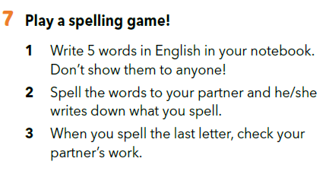
LET’S PLAY A SPELLING GAME!

Slide 10
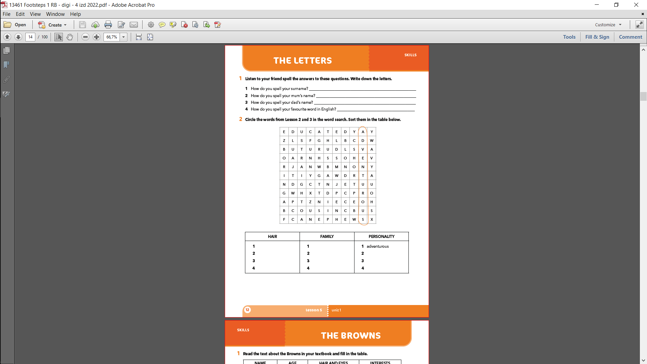
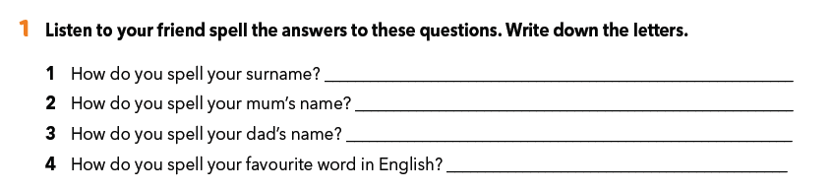

Slide 11
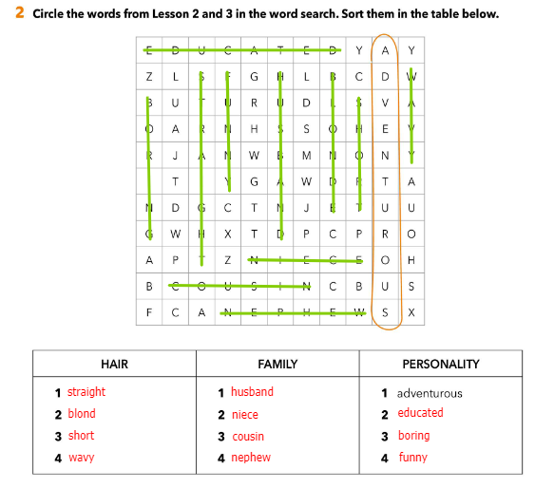

Slide 12
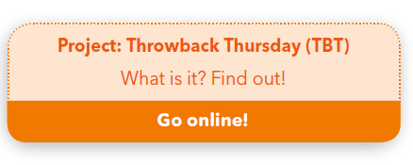
PROJECT TIME

Slide 13
SELF CHECK
https://www.e-sfera.hr/dodatni-digitalni-sadrzaji/2c5d7d36-9df0-42be-acb6-8292742ca509/

